Slide 1
UPS Data Analytics in SQL
By Sushant Shirsekar

Slide 2
Introduction
UPS is one of the largest logistics and package delivery companies in the world. Every single day, millions of parcels move through warehouses, sorting hubs, transport routes, and finally reach customers through delivery agents. In a system this big, even a small delay or inefficiency can turn into a major cost or customer experience issue.
As shipment volumes continue to grow, UPS faces common logistics challenges — delivery delays, inefficient routes, uneven workload across warehouses, and performance variations among delivery agents. These issues don’t just affect delivery time; they also impact fuel cost, operational efficiency, and most importantly, customer satisfaction.

Slide 3
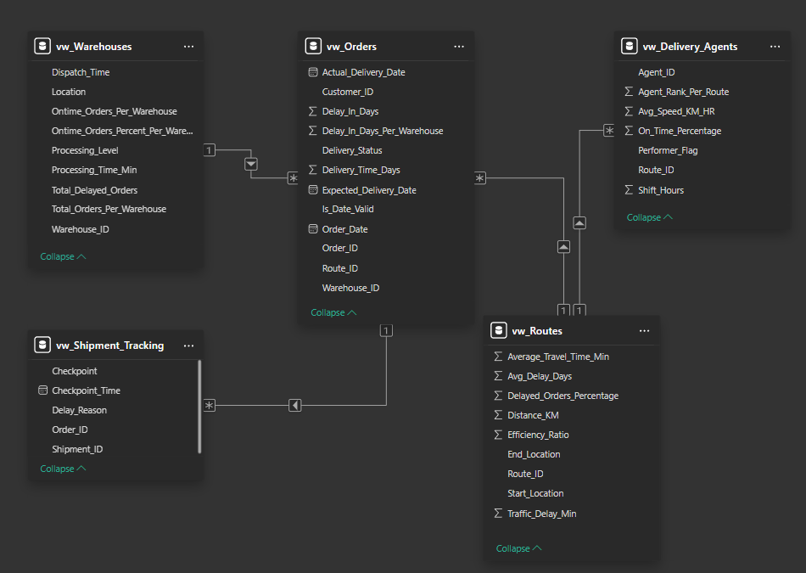
Data Model

Slide 4
Task 1 – Data Cleaning & Preparation
Objective:
Clean and standardize raw logistics data to ensure accuracy, consistency across all datasets, and valid date format and logic before analysis. This improves accuracy of Analysis
Analysis Covered:
  Remove duplicate Order IDs to avoid double counting of Orders.
  Replace null traffic delay values with Average to maintain accuracy in delay analysis.
  Standardize date formats to YYYY-MM-DD format for consistent date calculations.
  Validate delivery dates later than Order dates to ensure logical order timelines.

Slide 5
Identify and Delete Duplicate Order_ID Records.
Code :
SELECT Order_ID
FROM
(SELECT Order_ID, Order_Date
ROW_NUMBER() OVER(PARTITION BY Order_ID ORDER BY Order_Date) rn
FROM UPS.[Orders ]) as Alias
WHERE rn > 1;
DELETE FROM UPS.[Orders ]
WHERE Order_ID IN (
SELECT Order_ID
FROM (SELECT *,
ROW_NUMBER() OVER(PARTITION BY Order_ID ORDER BY Order_Date) rn
FROM UPS.[Orders ]) as Alias
WHERE rn > 1
);

Slide 6
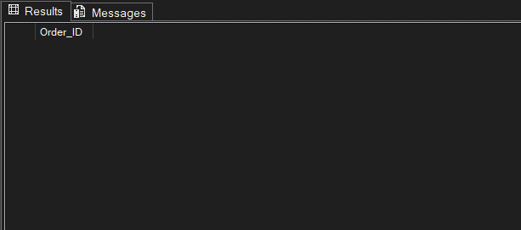
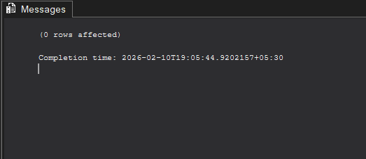
Identify and Delete Duplicate Order_ID Records.

Slide 7
Replace Null Traffic_Delay_Min with Average Traffic_Delay_Min
Code :
SELECT Route_ID, Traffic_Delay_Min FROM UPS.[Routes ]
WHERE Traffic_Delay_Min IS NULL;
UPDATE UPS.[Routes ]
SET Traffic_Delay_Min = (
SELECT AVG(Traffic_Delay_Min)
FROM UPS.[Routes ]
WHERE Traffic_Delay_Min IS NOT NULL
)
WHERE Traffic_Delay_Min IS NULL;

Slide 8
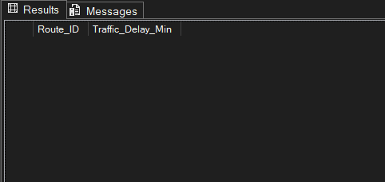
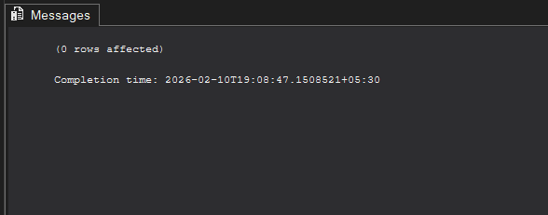
Replace Null Traffic_Delay_Min with Average Traffic_Delay_Min

Slide 9
Standardize Date formats to YYYY-MM-DD
Code :
SELECT
Order_ID,
Order_Date,
Expected_Delivery_Date,
Actual_Delivery_Date
FROM UPS.[Orders ];
UPDATE UPS.[Orders ]
SET Order_Date = CONVERT(DATE, Order_Date, 105),
Expected_Delivery_Date = CONVERT(DATE, Expected_Delivery_Date, 105),
Actual_Delivery_Date = CONVERT(DATE, Actual_Delivery_Date, 105);

Slide 10
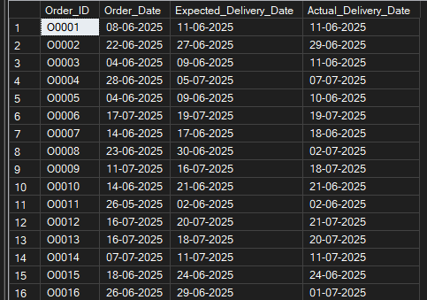
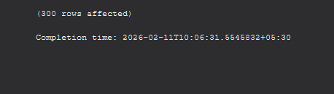
Standardize Date formats to YYYY-MM-DD

Slide 11
Ensure that no Actual_Delivery_Date is before Order_Date (flag such records).
Code :
SELECT
Order_ID, Order_Date,
Expected_Delivery_Date, Actual_Delivery_Date
FROM UPS.[Orders ]
WHERE Actual_Delivery_Date < Order_Date;
ALTER TABLE UPS.Orders
ADD Is_Date_Valid VARCHAR(20);
UPDATE UPS.[Orders ]
SET Is_Date_Valid =
CASE WHEN Actual_Delivery_Date < Order_Date THEN 'Invalid Date'
ELSE 'Valid Date'
END;

Slide 12
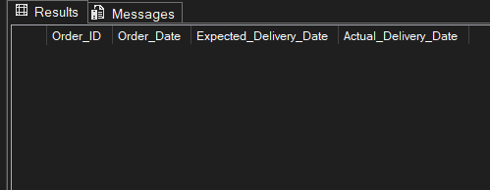
Ensure that no Actual_Delivery_Date is before Order_Date (flag such records).

Slide 13
Task 2: Delivery Delay Analysis
Objective:
Study delivery data to find delays, measure how efficient routes are, and detect delay trends at different warehouses to improve operations. This supports better decisions in logistics performance.
Analysis Covered:
  Calculate delivery delay in days for each order to measure performance gaps.
  Identify Top 10 delayed routes based on average delay days.
  Rank orders by delay within each warehouse using window functions to detect internal performance issues.

Slide 14
Calculate delivery delay (in days) for each order
Code :
SELECT
Order_ID,
Order_Date,
Expected_Delivery_Date,
Actual_Delivery_Date,
Delivery_Status,
DATEDIFF(DAY, Expected_Delivery_Date, Actual_Delivery_Date) Delay_In_Days
FROM UPS.[Orders ];

Slide 15
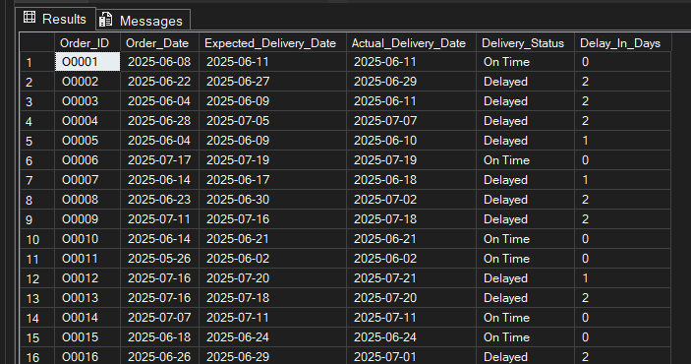
Calculate delivery delay (in days) for each order

Slide 16
Find Top 10 delayed Routes based on Average Delay Days.
Code :
SELECT TOP 10
r.Route_ID, r.Start_Location,
r.End_Location, r.Distance_KM,
r.Average_Travel_Time_Min, r.Traffic_Delay_Min,
ROUND(
AVG(CAST(DATEDIFF(DAY, o.Expected_Delivery_Date, o.Actual_Delivery_Date) AS FLOAT) ),2) Avg_Delay_In_Days
FROM UPS.[Orders ] o
JOIN UPS.[Routes ] r ON o.Route_ID = r.Route_ID
GROUP BY
r.Route_ID, r.Start_Location,
r.End_Location, r.Distance_KM,
r.Average_Travel_Time_Min, r.Traffic_Delay_Min
ORDER BY Avg_Delay_In_Days DESC, r.Route_ID;

Slide 17
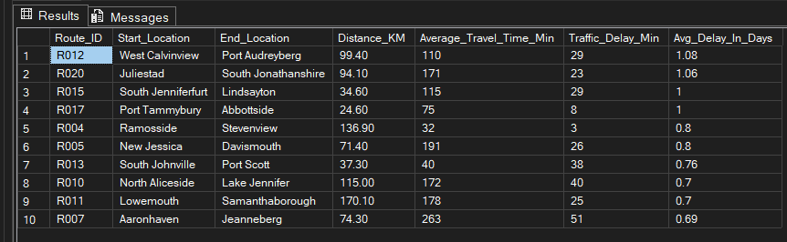
Top 10 delayed routes based on average delay days.

Slide 18
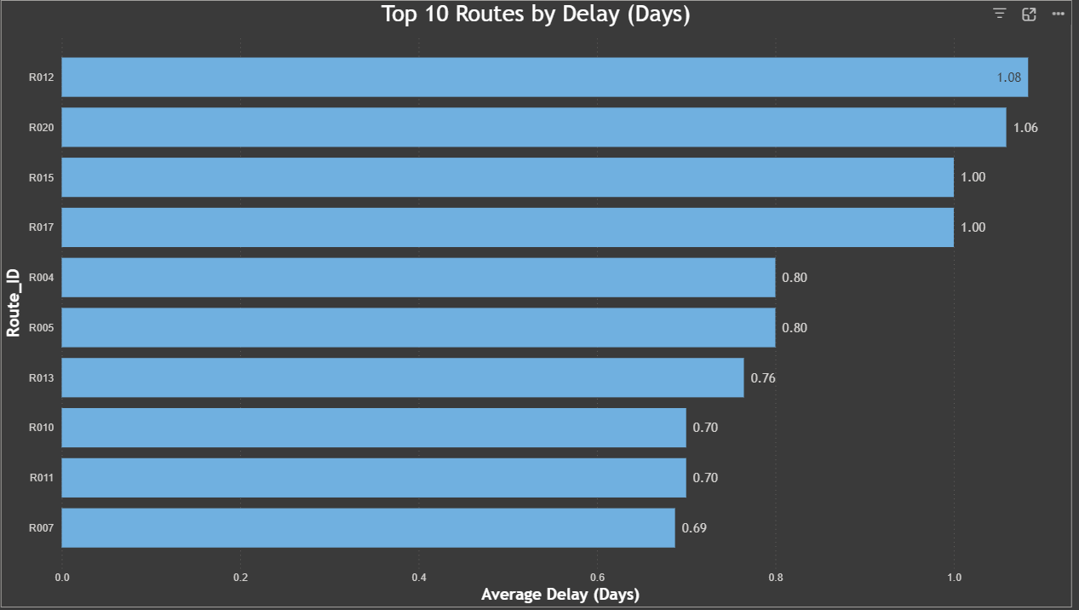
Top 10 delayed routes based on average delay days.

Slide 19
Use window functions to rank all orders by delay within each warehouse.
Code :
SELECT
Warehouse_ID, Order_ID,
Order_Date, Expected_Delivery_Date,
Actual_Delivery_Date, Delivery_Status,
DATEDIFF(DAY, Expected_Delivery_Date, Actual_Delivery_Date) Delay_In_Days,
DENSE_RANK() OVER (
PARTITION BY Warehouse_ID
ORDER BY DATEDIFF(DAY, Expected_Delivery_Date, Actual_Delivery_Date) DESC
) AS Rank_Per_Order_By_Warehouse
FROM UPS.[Orders ];

Slide 20
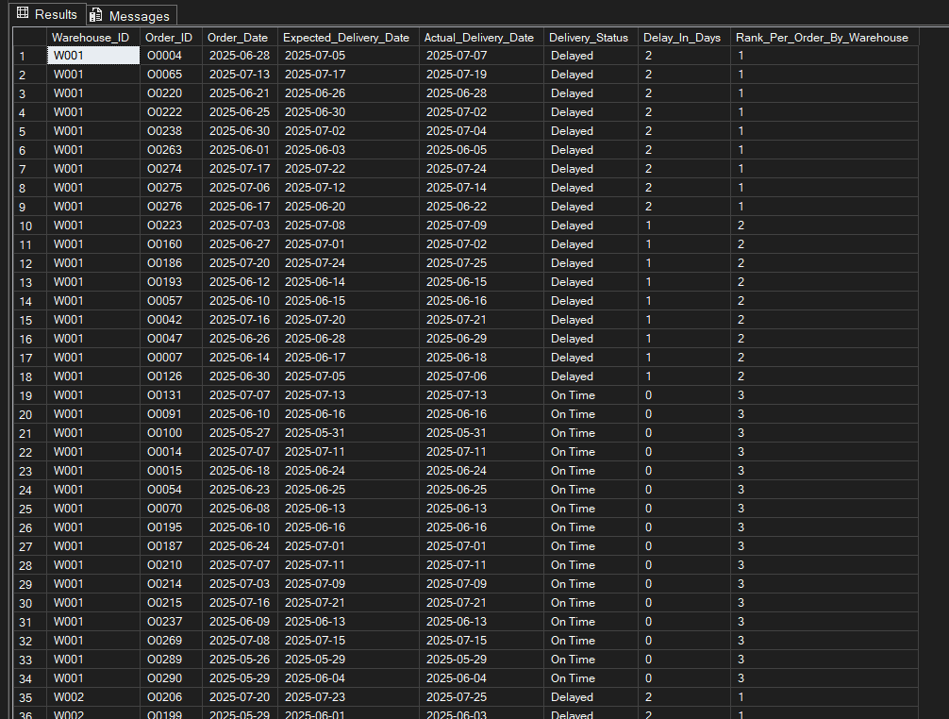
Top 10 delayed routes based on average delay days.

Slide 21
Task 3: Route Optimization Insights
Objective:
Evaluate route performance to uncover inefficiencies, delay patterns, and improvement opportunities in transportation operations. This supports data-driven decisions for logistics optimization.
Subtasks Covered:
  Calculate average delivery time, average traffic delay, and distance-to-time efficiency ratio for each route.
  Identify 3 routes with the worst efficiency ratio to detect performance bottlenecks.
  Find routes with more than 20% delayed shipments to highlight reliability issues.
  Recommend potential routes for optimization based on performance indicators.

Slide 22
Average Delivery Time (in days) and Traffic Delay for each Route
Code :
SELECT
Route_ID,
ROUND(AVG(CAST(DATEDIFF(day, Order_Date, Actual_Delivery_Date) AS FLOAT)),2) Delivery_Time_Days
FROM UPS.[Orders ]
GROUP BY Route_ID
ORDER BY Delivery_Time_Days DESC, Route_ID;
SELECT
Route_ID,
AVG(Traffic_Delay_Min) OVER(PARTITION BY Route_ID) as Avg_Traffic_Delay
FROM UPS.[Routes ]
ORDER BY Avg_Traffic_Delay DESC, Route_ID;

Slide 23
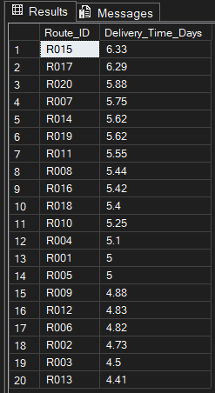
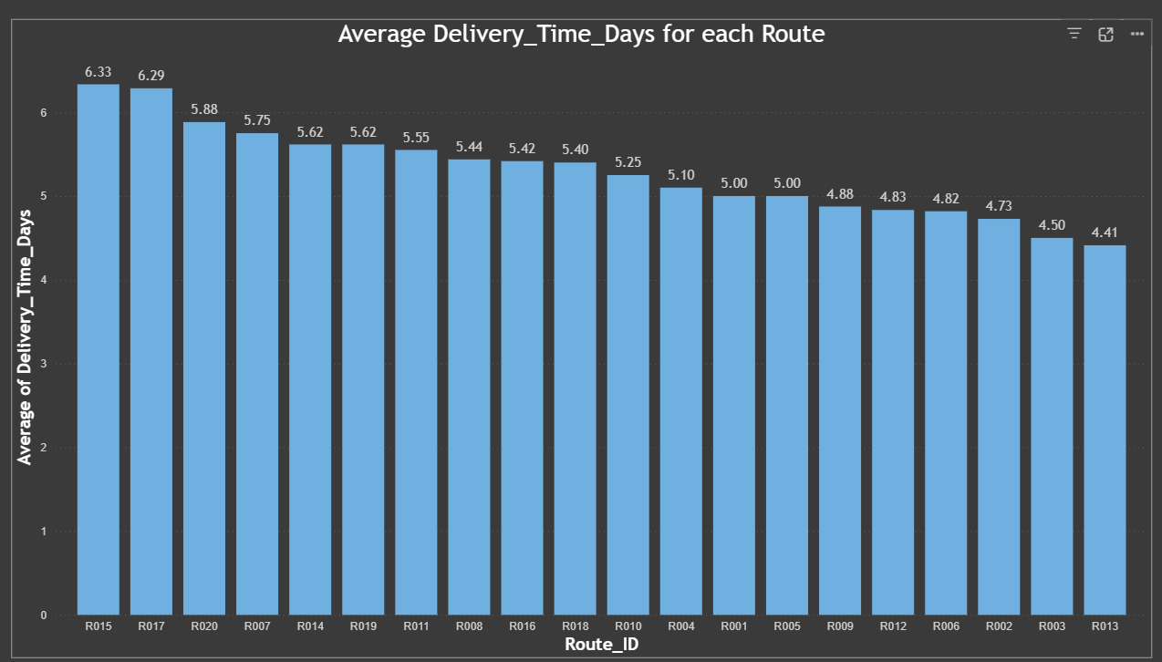
Average Delivery Time (in days) for each Route

Slide 24
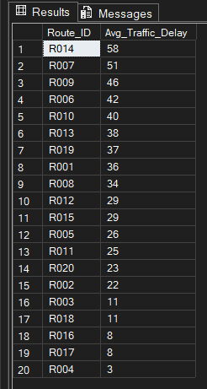
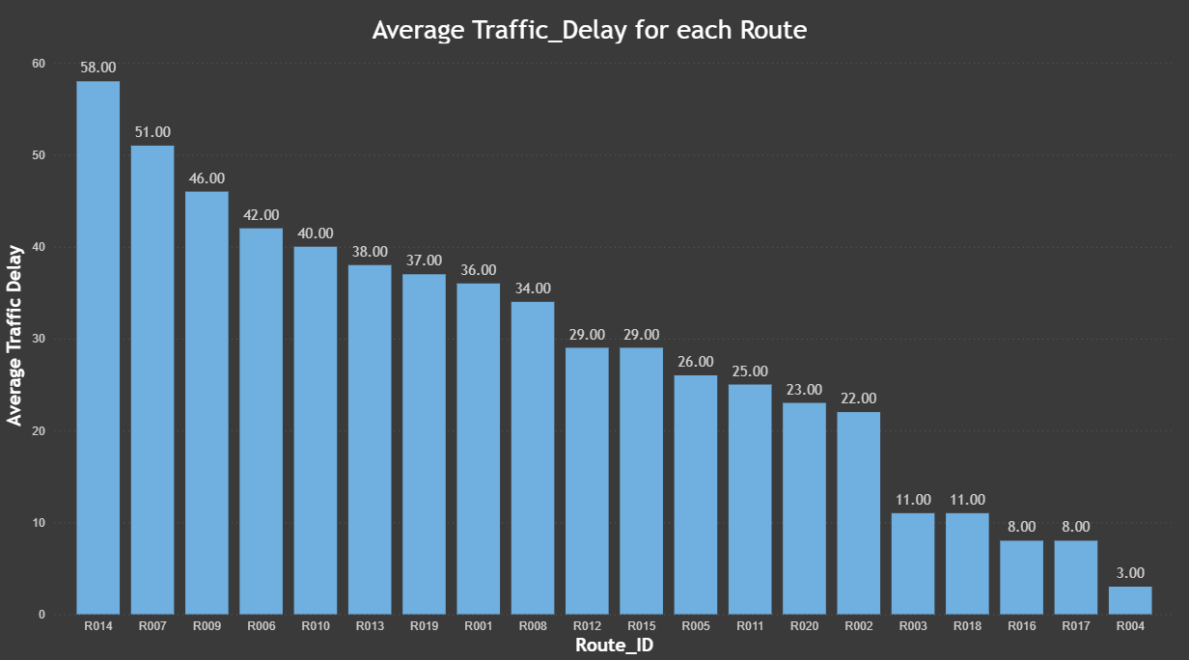
Average Traffic Delay for each Route

Slide 25
Distance to Time Efficiency Ratio for each Route
Code :
SELECT
Route_ID,
CAST
(ROUND(
Distance_KM * 1.0 / Average_Travel_Time_Min, 2) AS DECIMAL(10,2)) Efficiency_Ratio
FROM UPS.[Routes ]
ORDER BY Efficiency_Ratio, Route_ID DESC;

Slide 26
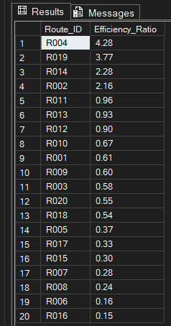
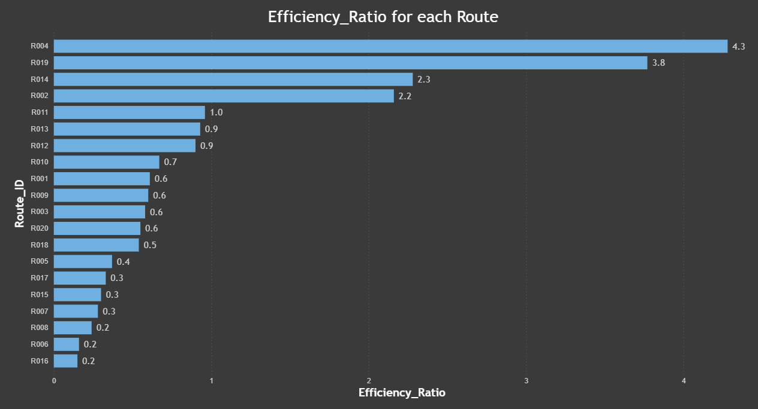
Distance to Time Efficiency Ratio for each Route

Slide 27
Top 3 Routes with the worst Efficiency Ratio
Code :
SELECT TOP 3
Route_ID,
ROUND(CAST(Distance_KM * 1.0 / Average_Travel_Time_Min AS FLOAT) ,2) as Efficiency_Ratio
FROM UPS.[Routes ]
ORDER BY Efficiency_Ratio, Route_ID;

Slide 28
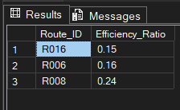
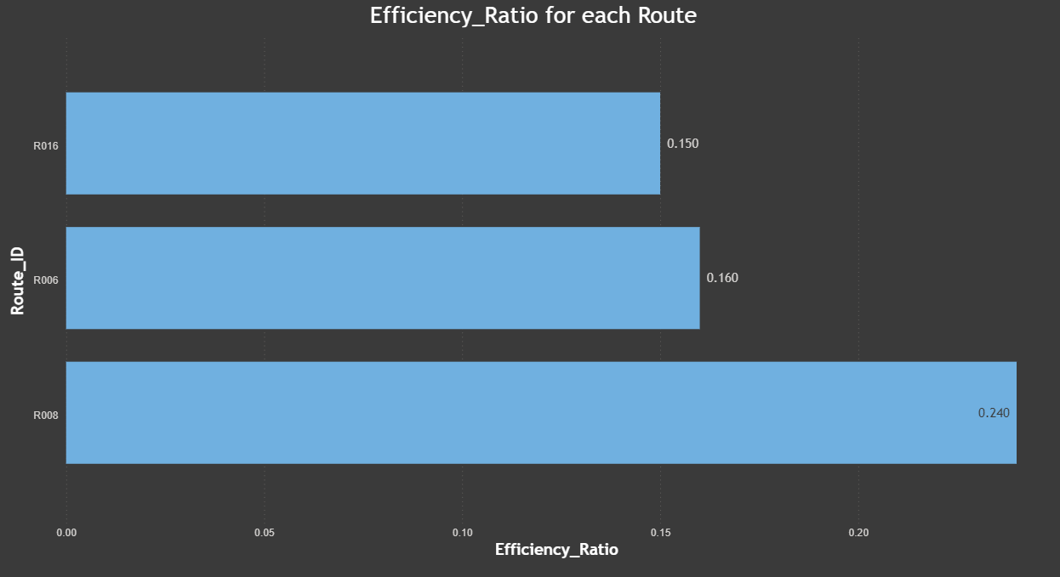
Top 3 Routes with the worst Efficiency Ratio

Slide 29
Routes with more than 20% Delayed Shipments
Code :
SELECT Route_ID,
Delayed_Orders_Per_Route, Total_Orders_Per_Route,
CAST(100 * Delayed_Orders_Per_Route / Total_Orders_Per_Route AS DECIMAL(5,2) ) Delayed_Percentage
FROM
(SELECT Route_ID,
COUNT(*) Total_Orders_Per_Route,
SUM(CASE WHEN Delivery_Status = 'Delayed' THEN 1
ELSE 0
END) AS Delayed_Orders_Per_Route
FROM UPS.[Orders ]
GROUP BY Route_ID ) t
ORDER BY Delayed_Percentage DESC, Route_ID;

Slide 30
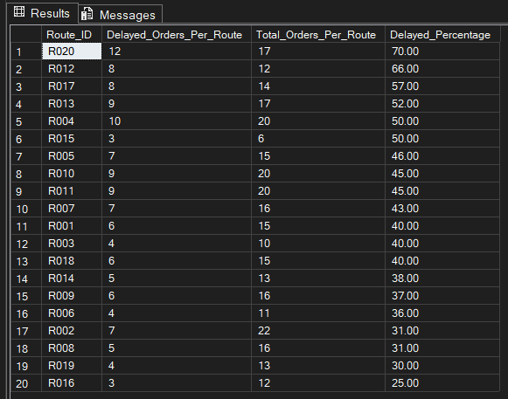
Routes with more than 20% Delayed Shipments

Slide 31
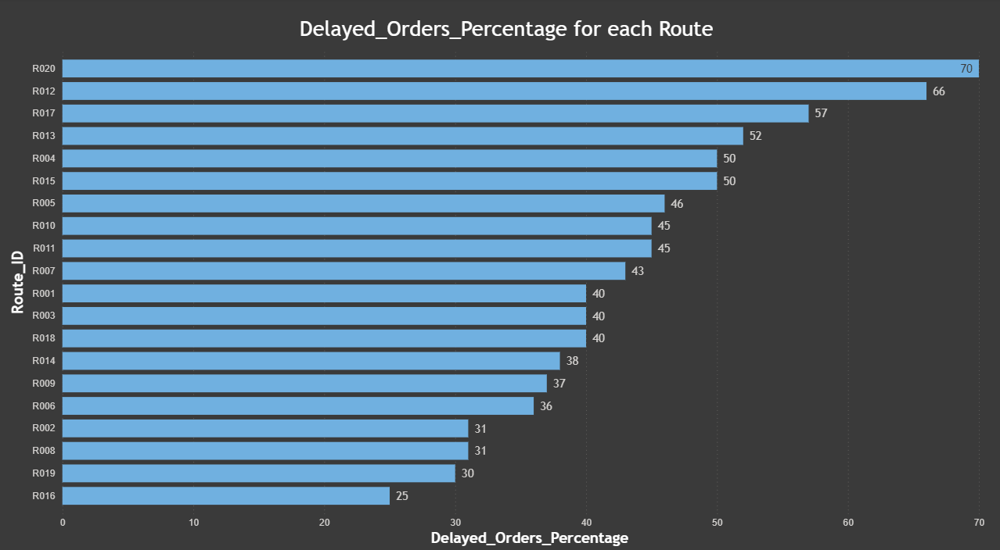
Routes with more than 20% Delayed Shipments

Slide 32
Recommendations – Routes Performance
R016, R006, and R008 need urgent improvement because they have the worst efficiency ratios. This means they take more time compared to the distance covered, so route planning or road conditions should be reviewed.
Routes like R020 and R012 show very high delay percentages, so delivery schedules on these routes should be rechecked and buffer time may be required.
R014 and R007 have high traffic delays, which indicates congestion issues. Alternative roads or different delivery time slots (non-peak hours) can reduce delay.
Routes with high delivery time but moderate distance (like R015 and R017) suggest operational inefficiency, so driver performance or stop management should be analyzed.
Routes with low efficiency but high delay % should be prioritized first, as they impact both speed and service reliability.
Overall, combining traffic management, route redesign, and schedule adjustment can significantly improve delivery performance on the identified routes.

Slide 33
Task 4: Warehouse Performance
Objective:
Evaluate warehouse performance to identify processing inefficiencies, delay contributors, and operational bottlenecks. This enables data-driven decisions for warehouse optimization and resource planning.
Subtasks Covered:
  Calculate average processing time for each warehouse to measure operational speed.
  Identify the top 3 warehouses with the highest average processing time to detect slow-performing facilities.
  Compute total shipments vs. delayed shipments for every warehouse to assess reliability.
  Use CTEs to find bottleneck warehouses where processing time exceeds the global system average.
  Rank warehouses based on on-time delivery percentage to compare performance levels.

Slide 34
Top 3 Warehouses with the Highest Average Processing Time
Code :
SELECT TOP 3
Warehouse_ID,
AVG(Processing_Time_Min) AS Top_3_avg_processing_time
FROM UPS.[Warehouses ]
GROUP BY Warehouse_ID
ORDER BY AVG(Processing_Time_Min) DESC, Warehouse_ID;

Slide 35
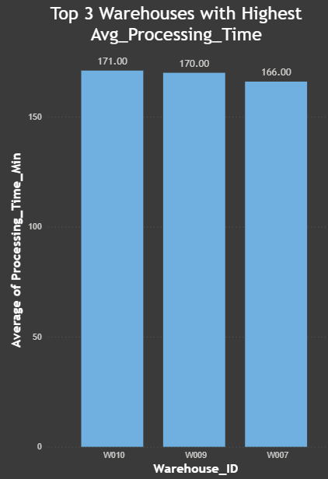
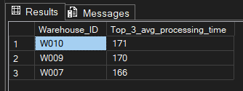
Top 3 Warehouses with the Highest Average Processing Time

Slide 36
Total vs. Delayed Orders per Warehouse
Code :
SELECT
Warehouse_ID,
COUNT(*) Total_Orders_Per_Warehouse,
SUM(CASE
WHEN Delivery_Status = 'Delayed' THEN 1
ELSE 0
END) Delayed_Orders_Per_Warehouse
FROM UPS.[Orders ]
GROUP BY Warehouse_ID;

Slide 37
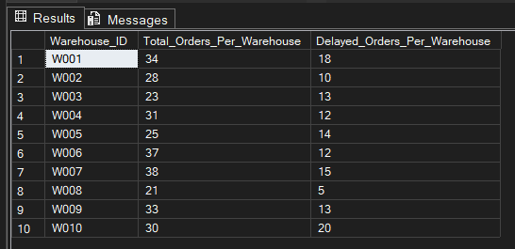
Top 3 Warehouses with the Highest Average Processing Time

Slide 38
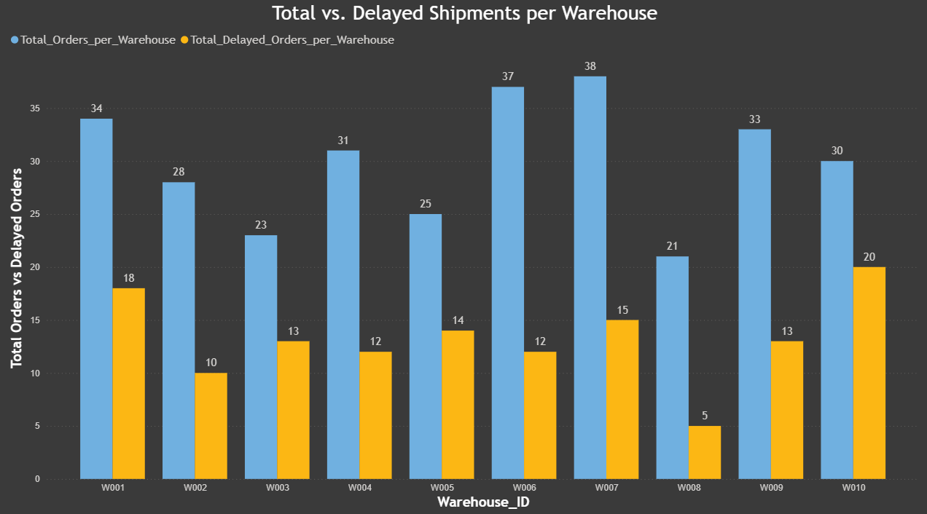
Top 3 Warehouses with the Highest Average Processing Time

Slide 39
Bottleneck Warehouses where Processing_Time > Global Average
Code :
WITH Global_Average_Processing_Time AS (
SELECT
AVG(Processing_Time_Min) AS Global_Avg_Time
FROM UPS.[Warehouses ])
SELECT
w.Warehouse_ID,
w.Processing_Time_Min,
ga.Global_Avg_Time
FROM UPS.[Warehouses ] AS w, Global_Average_Processing_Time AS ga
WHERE w.Processing_Time_Min > ga.Global_Avg_Time;

Slide 40
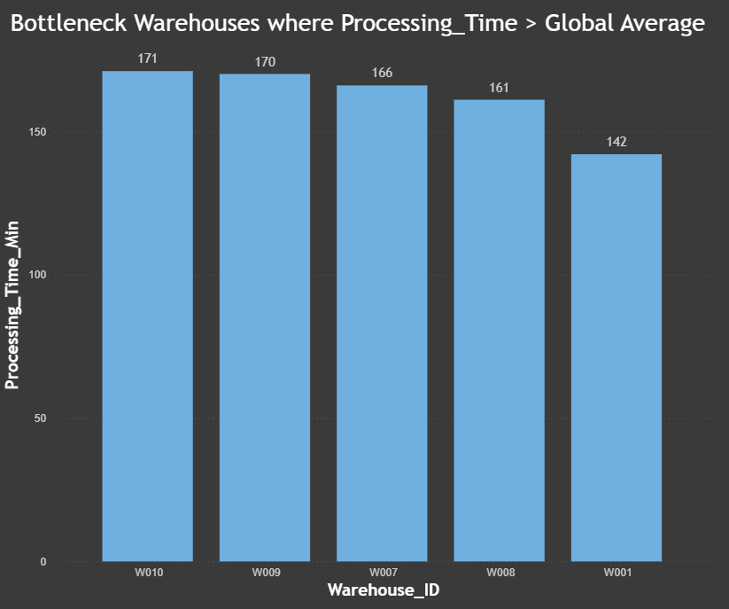
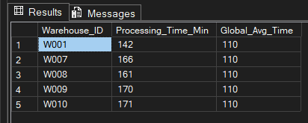
Bottleneck Warehouses where Processing_Time > Global Average

Slide 41
Warehouses based on on-time Delivery Percentage
Code :
SELECT Warehouse_ID,
COUNT(*) Total_Orders_Per_Warehouse,
SUM(CASE WHEN Delivery_Status = 'On Time' THEN 1
ELSE 0
END) Ontime_Orders_Per_Warehouse,
CAST(100 * SUM(CASE WHEN Delivery_Status = 'On Time' THEN 1
ELSE 0
END) / COUNT(*) AS decimal(5,2)) Ontime_Orders_Percent,
DENSE_RANK() OVER(ORDER BY
CAST(100 * SUM(CASE WHEN Delivery_Status = 'On Time' THEN 1
ELSE 0
END) / COUNT(*) AS decimal(5,2)) DESC) Warehouse_Rank
FROM UPS.[Orders ]
GROUP BY Warehouse_ID;

Slide 42
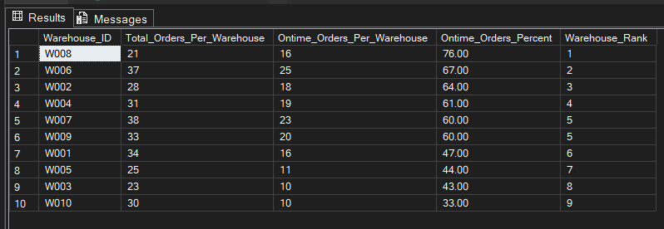
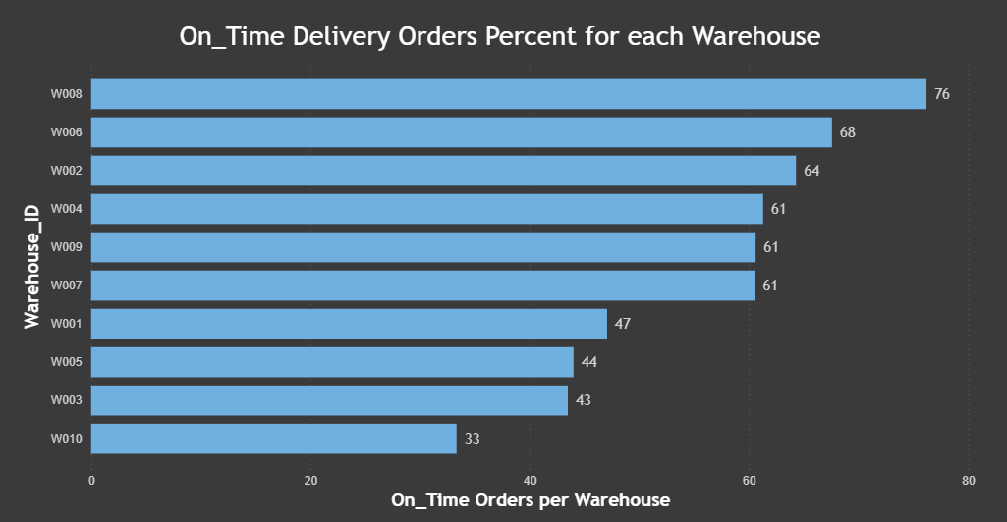
Warehouses based on on-time Delivery Percentage

Slide 43
Recommendations — Warehouse Optimizations
Warehouses like W010, W009, and W007 have the highest average processing times, so workload distribution and staff efficiency should be reviewed. Extra manpower or better task allocation may help reduce processing delays.
Warehouses identified as bottlenecks (processing time above global average) should be prioritized for operational improvement. Process flow, inventory handling, and system delays in these warehouses need analysis.
Warehouses with high delayed shipment counts compared to total shipments indicate reliability issues. These locations may need better coordination between dispatch teams and transportation units.
Warehouses with low on-time delivery percentage should review internal scheduling and order handling procedures. Delays might be happening before shipment leaves the warehouse.
Comparing top-performing warehouses with low-performing ones can help identify best practices that can be implemented across other warehouses.
If certain warehouses consistently show high processing times, automation tools or better warehouse management systems could improve performance.
Regular monitoring of warehouse KPIs like processing time, delay percentage, and shipment volume will help in early identification of future bottlenecks.

Slide 44
Task 5: Delivery Agents Performance
Objective:
Assess delivery agents to see how on-time, efficient, and dependable they are across different routes. This analysis highlights top performers, agents who need improvement, and gaps in last-mile operations. The insights help with better route assignment, focused training, and improved service quality.
Subtasks Covered:
Calculate on-time delivery percentage for each delivery agent to measure punctuality performance.
Rank delivery agents within each route based on on-time delivery percentage to ensure fair performance comparison.
Identify agents with on-time delivery below 80% to detect reliability issues and areas needing improvement.
Compute average travel speed (Distance / Travel Time) to measure operational efficiency.
Use subqueries to compare average speed of top 5 vs bottom 5 agents, highlighting the performance gap between high and low performers.

Slide 45
Agents (per route) by On-Time Delivery Percentage
Code :
SELECT
Route_ID,
Agent_ID,
On_Time_Percentage,
DENSE_RANK() OVER(PARTITION BY Route_ID ORDER BY On_Time_Percentage DESC) Agent_Rank
FROM UPS.Delivery_Agents;

Slide 46
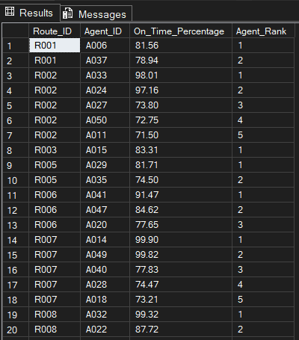
Agents (per route) by On-Time Delivery Percentage

Slide 47
Agents with on-time Percentage less than 80%
Code :
SELECT
Agent_ID,
On_Time_Percentage
FROM UPS.Delivery_Agents
WHERE On_Time_Percentage < 80
ORDER BY On_Time_Percentage DESC;

Slide 48
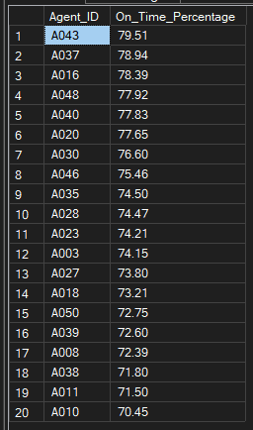
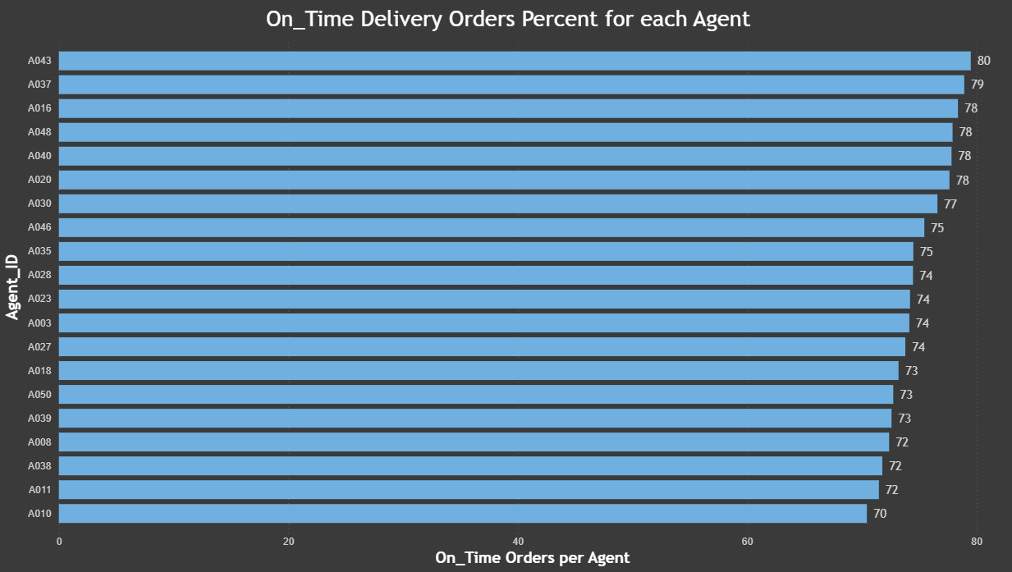
Agents with on-time Percentage less than 80%

Slide 49
Average Speed of Top 5 vs Bottom 5 Agents
Code :
SELECT
(SELECT AVG(Avg_Speed_KM_HR) FROM (
SELECT TOP 5 Avg_Speed_KM_HR
FROM UPS.Delivery_Agents
ORDER BY On_Time_Percentage DESC
) AS Top_Delivery_Agents
) AS Top_5_Avg_Speed,
(SELECT AVG(Avg_Speed_KM_HR) FROM (
SELECT TOP 5 Avg_Speed_KM_HR
FROM UPS.Delivery_Agents
ORDER BY On_Time_Percentage ASC
) AS Bottom_Delivery_Agents
) AS Bottom_5_Avg_Speed;

Slide 50

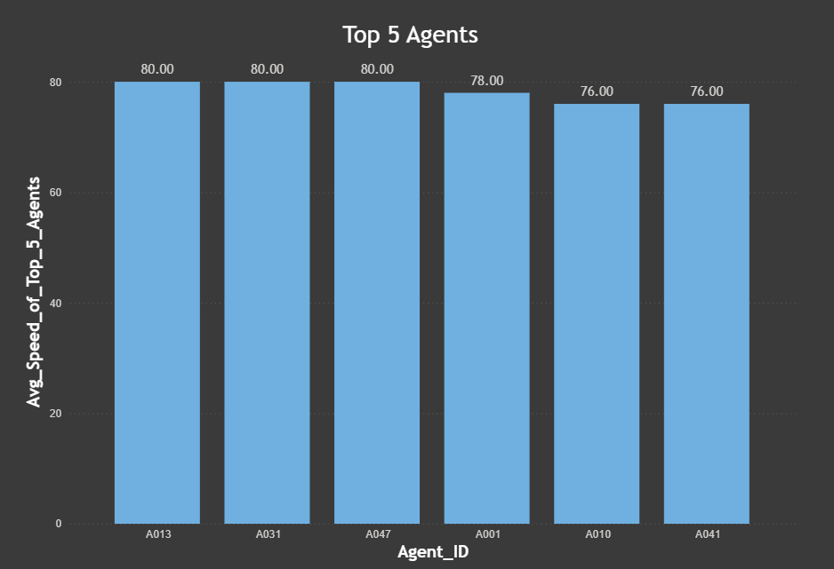
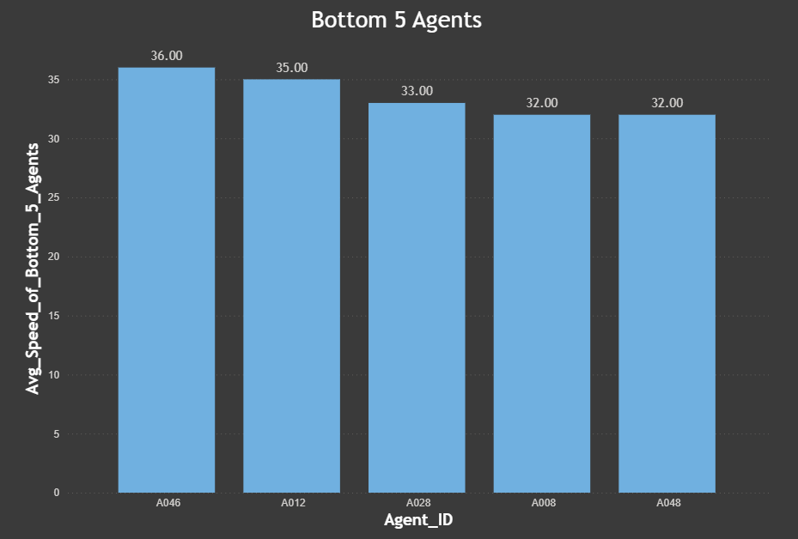
Average Speed of Top 5 vs Bottom 5 Agents

Slide 51
Recommendations — Agents Performance
Agents with on-time delivery below 80% need immediate attention. These 20 agents should receive additional training on route optimization and time management to improve their delivery efficiency.
Route R002 has multiple underperforming agents (5 agents below 80%), which suggests either the route itself is problematic or there's a need for better coordination. This route should be reviewed for possible redesign or redistribution of delivery zones.
The significant speed difference between top performers (78 average speed) and bottom performers (33 average speed) shows that faster agents are more likely to deliver on time. Speed improvement programs or vehicle upgrades for slower agents could help close this gap.
Top-performing agents like A014 (99.90%), A049 (99.82%), and A032 (99.32%) should be recognized and their delivery methods should be documented as best practices for training other agents.
Agents ranked lower on their routes should be paired with top performers for mentoring. Learning from high-ranking colleagues can help them understand better routing decisions and time-saving techniques.
Some routes like R007 and R008 have wide performance variations between agents, indicating that success on these routes depends heavily on individual strategy rather than route difficulty. Sharing successful approaches across agents on the same route could level up performance.
Regular performance reviews focusing on on-time percentage and delivery speed will help identify declining performance early and allow for corrective action before it affects customer satisfaction.

Slide 52
Task 6: Shipment Tracking Analytics
Objective:
Study shipment tracking data to follow delivery movement, spot delay trends, and find shipments facing issues. This helps increase logistics visibility, lower bottlenecks, and improve operational control throughout the delivery process.
Subtasks Covered:
Retrieve the last checkpoint and corresponding timestamp for each order to determine the latest shipment status.
Analyze tracking records to find the most common delay reasons (excluding “None”) to understand major operational disruptions.
Identify orders with more than two delayed checkpoints to detect shipments at high risk of significant delay.
Use tracking data to uncover patterns in shipment movement and delay accumulation across routes.
Support proactive intervention by highlighting orders requiring attention from operations teams.

Slide 53
Last Checkpoint and Time for each Order
Code :
SELECT
Order_ID,
[Checkpoint ],
Checkpoint_Time
FROM
(SELECT
Order_ID,
[Checkpoint ],
Checkpoint_Time,
Row_Number()
OVER(PARTITION BY Order_ID ORDER BY Checkpoint_Time DESC, [Checkpoint ] DESC) rn
FROM UPS.Shipment_Tracking) t
WHERE rn = 1;

Slide 54
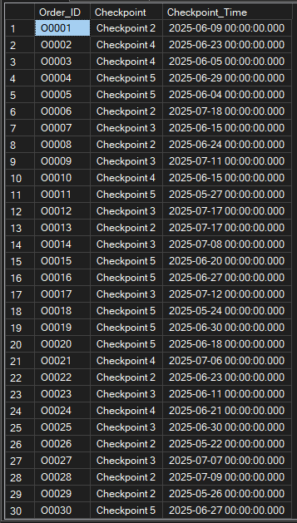
Last Checkpoint and Time for each Order

Slide 55
Most Common Delay Reasons for Orders
Code :
SELECT
Delay_Reason,
COUNT(*) Frequency_Of_Delay_Reasons
FROM UPS.Shipment_Tracking
WHERE Delay_Reason <> 'None'
GROUP BY Delay_Reason
ORDER BY COUNT(*) DESC;

Slide 56

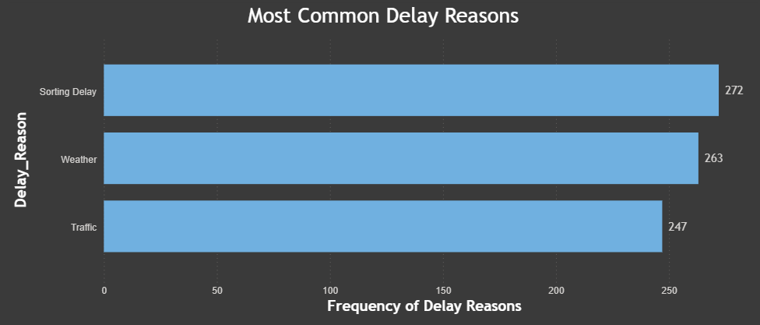
Most Common Delay Reasons for Orders

Slide 57
Orders with more than 2 Delayed Checkpoints
Code :
SELECT
Order_ID,
COUNT(*) No_Of_Checkpoints
FROM UPS.Shipment_Tracking
WHERE Delay_Reason <> 'None’
AND Delay_Reason IS NOT NULL
GROUP BY Order_ID
HAVING COUNT(*) > 2
ORDER BY No_Of_Checkpoints DESC, Order_ID;

Slide 58
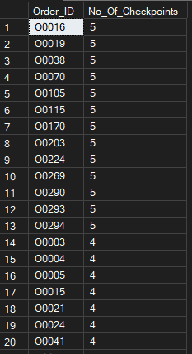
Orders with more than 2 Delayed Checkpoints

Slide 59
Task 7: Advanced KPI Reporting
Objective:
Create detailed KPI reports to track delivery performance across different regions and routes. This analysis helps understand delay trends, service reliability, and traffic effects, supporting smarter planning and better logistics operations.
Subtasks Covered:
Calculate Average Delivery Delay per Region (Start Location) to identify geographical areas contributing most to delays.
Compute On-Time Delivery Percentage to evaluate overall service reliability using the formula:
(On-Time Deliveries / Total Deliveries) × 100.
Measure Average Traffic Delay per Route to understand the impact of road and congestion conditions on delivery efficiency.
Use SQL-based KPI aggregation to transform raw operational data into performance indicators.
Support management decision-making by highlighting delay-prone regions and traffic-affected routes.

Slide 60
Average Delivery Delay per Region (Start_Location)
Code :
SELECT
Start_Location,
AVG(Traffic_Delay_Min) Avg_Delay_Per_Region
FROM UPS.[Routes ]
GROUP BY Start_Location;

Slide 61
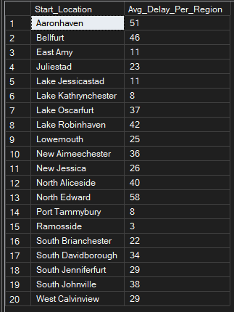
Average Delivery Delay per Region (Start_Location)

Slide 62
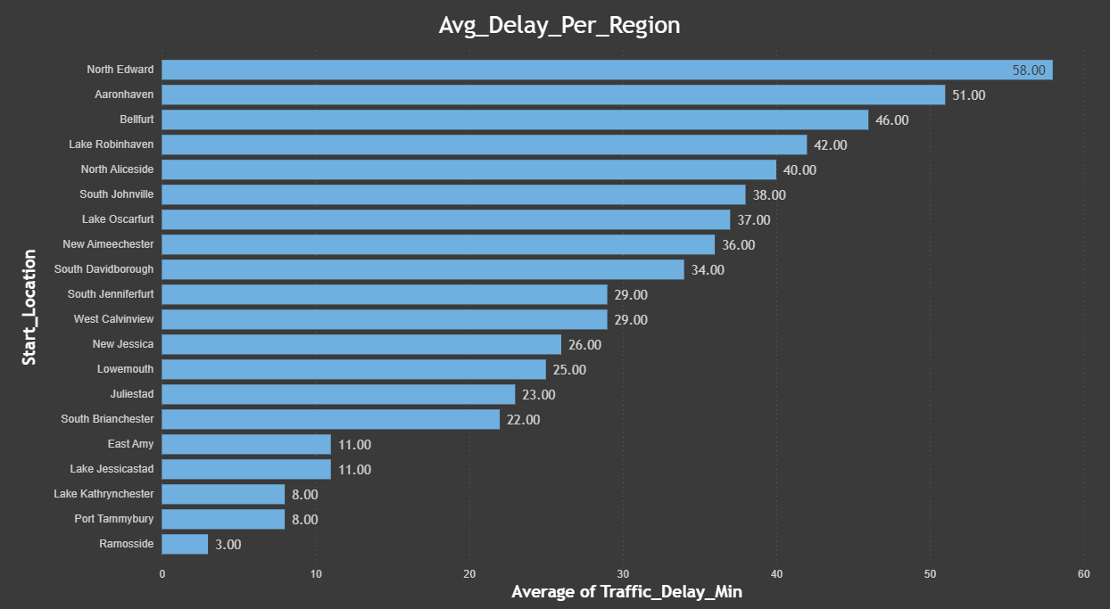
Average Delivery Delay per Region (Start_Location)

Slide 63
On-Time Delivery %
Code :
SELECT
CAST(100 *
SUM(CASE
WHEN Delivery_Status = 'On Time' THEN 1
ELSE 0
END) / COUNT(*)
AS DECIMAL(5,2)) AS On_Time_Delivery_Percent
FROM UPS.[Orders ];

Slide 64

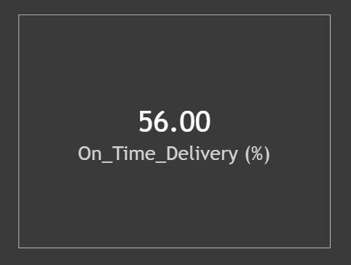
On-Time Delivery %

Slide 65
Average Traffic Delay per Route
Code :
SELECT
CAST(100 *
SUM(CASE
WHEN Delivery_Status = 'On Time' THEN 1
ELSE 0
END) / COUNT(*)
AS DECIMAL(5,2)) AS On_Time_Delivery_Percent
FROM UPS.[Orders ];

Slide 66
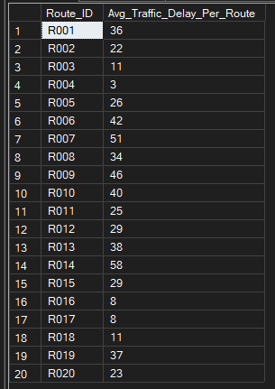
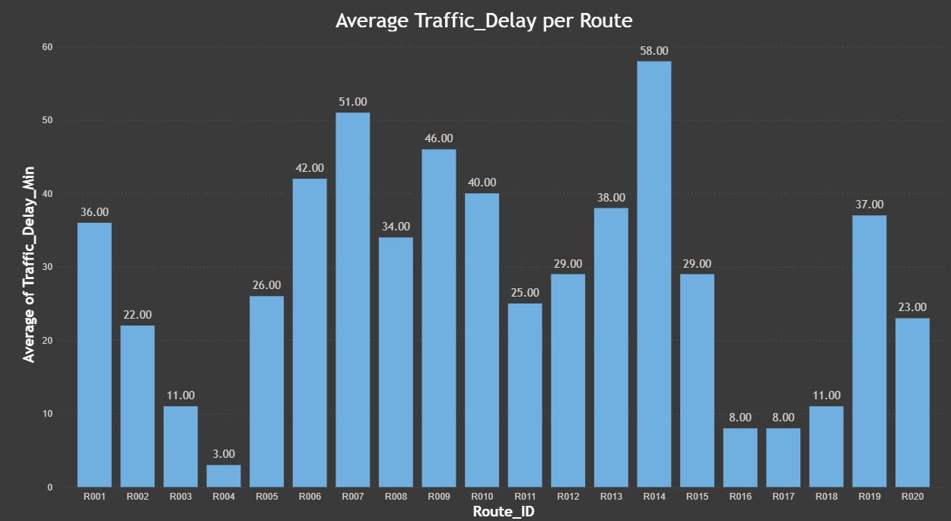
Average Traffic Delay per Route

Slide 67
Thank you
By Sushant Shirsekar

Slide 68
Drive Link
https://drive.google.com/file/d/13x_QEHAQP6ZMNEmWCSKCk96A6FbHWeBr/view?usp=sharing

